Slide 1

Anatomy and Physiology

Slide 2
Develop Study Guide
You need to be able to label the anatomical parts for the diagrams (you do not need to identify ligaments).
For each body part identified, create a table with functions like the sample below
Name of part | Male, Female or Both | Function

Slide 3
Also be able to…
Briefly explain how menstruation and ovulation are connected.
List four phases of Masters and Johnson’s Sexual Response Cycle
  Provide a brief description of each phase.
  Identify when myotonia and vasocongestion occur
  Identify how other models of sexual response differ from Masters and Johnson

Slide 4
Female Sexual Anatomy & Physiology

Slide 5
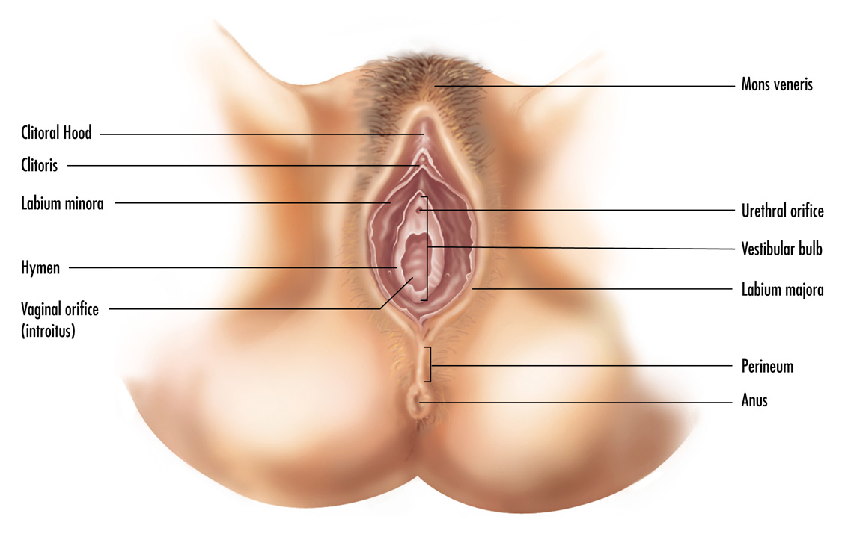
Female External Genitals
Notes:
Vulva – external female genitilia
Vagina – is an internal structure
The external genitals:
Mons veneris – mons pubis pad of fatty tissue that covers public bone
Labia majoria
Labia minora
Clitoris – center of sexual arousal, high concentration of nerve endings, sole function is sexual arousal
Vestibule – area enclosed by labia minora
Urethral opening
Hymen – named for Roman god of marriage, thin membrane
two small ducts from Barhtolin’s glands or vestibular glands – secret a small amount of moisture during sex
The internal genitals:
Vagina – from latin word for sheath, flexible muscular structure – two functions – encompasses penis during coitus and birth canal
Grafenberg Spot
Female prostrate – Skene gland, suggested source of female ejaculate
Uterus – cervix, os
Fallopian tubes and ovaries

Slide 6
Structure of clitoris
Glans of clitoris is external – most of structure is internal
Check out this Betty Dodson video to learn more:
  https://www.youtube.com/watch?v=YhoSUoZ_uJ0
  (note Betty does use some slang terminology)

Slide 7
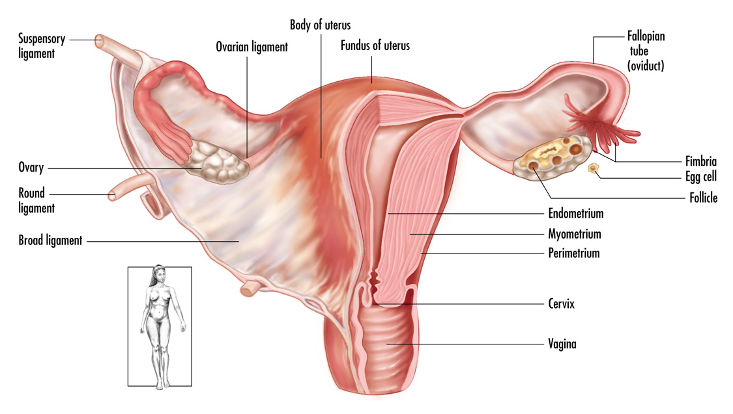
Female Internal Genitals
Notes:
The internal genitals:
Vagina
Grafenberg Spot
Female prostrate
Uterus
Fallopian tubes and ovaries

Slide 8
Two Cycles
Ovarian
  follicular – GnRH from hypothalamus → stimulates pituitary to release FSH and LH – which develops follicles and these secret estrogen
  ovulatory - ~day 11-14 Increase LH, ovulation occurs
  Luteal – 14 days, pregnancy or corpus luteum deteriorates
Notes:
Gonadotropin releasing hormone released from hypothalamus → stimulates pituitary to release FSH and LH – which develops follicles and these secret estrogen

Slide 9
Two cycles
Menstrual cycle
  Menstrual phase – shedding of endometrium, 3-5 days FSH and LH start increase ~ day 5
  Proliferative – ~9 days, Increased estrogen, endometrium thickens, this phase ends with ovulation
  Secretory phase – progesterone helps prepare for arrival of fertilized ovum, corresponds to luteal phase

Slide 10
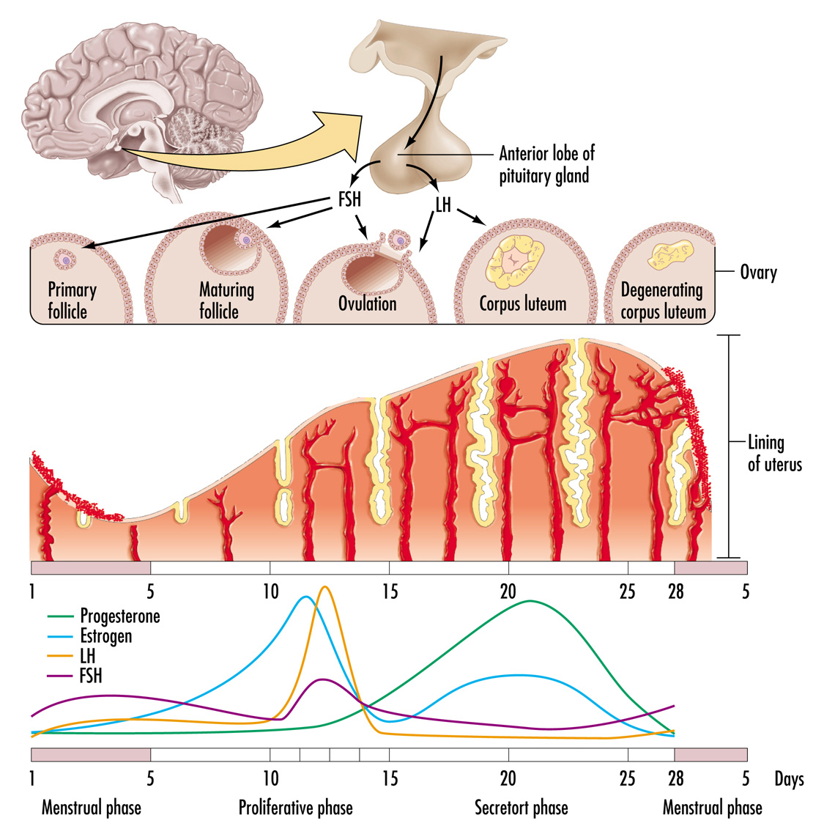
Menstruation
Notes:
Phases of the menstrual cycle:
Proliferative phase
Secretory/Luteal phase
Menstrual phase

Slide 11
Link between menstrual cycle & ovulation
https://iapmd.org/the-cycle

Slide 12
MALE SEXUAL ANATOMY AND PHYSIOLOGY

Slide 13
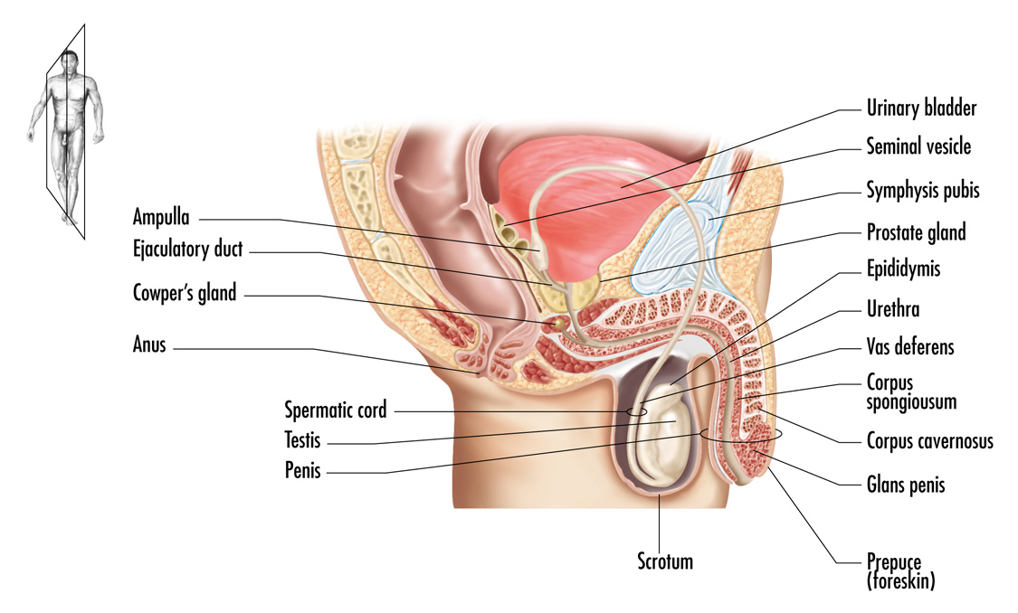
Male Internal Genitals
Notes:
External genitals:
The penis
Circumscision
The scrotum
Internal genitals:
The urethra
The corpora cavernosa and corpus spongiosum
The testis
Vas deferens
Seminiferous tubules
Epididymis
Pathway of the sperm:
Ampulla
Seminal vessicles
Prostrate gland
Cowper’s gland
Ejaculation and orgasm

Slide 14
Circumcision
Removal of male foreskin
Controversy
  Benefits
  Cons
7/12 - Germany bans circumcision
9/12 - AAP new policy statement
Notes:
AAP Statement Specific benefits identified included prevention of urinary tract infections, penile cancer, and transmission of some sexually transmitted infections, including HIV.
Evaluation of current evidence indicates that the health benefits of newborn male circumcision outweigh the risks and that the procedure’s benefits justify access to this procedure for families who choose it.
Older news:
"Routine Circumcision Could Reduce STD Rate"
USA Today (11.06.06):: Marilyn Elias
A new study in Pediatrics suggests routine male circumcision could reduce the rate of STDs by around half. The report adds to growing scientific evidence that runs contrary to an American Academy of Pediatrics (AAP) policy against the practice.
Researcher David Fergusson of New Zealand's Christchurch School of Medicine and Health Sciences and colleagues followed 510 New Zealand newborns until age 25. Even after adjusting for other key factors linked to STDs - number of sexual partners, unprotected sex and family demographics - youths who were circumcised were far less likely to become infected. It is believed that the warm, moist area under the foreskins of uncircumcised men functions as a catalyst for infections.
Since AAP came out against routine circumcision in 1999, mounting research has shown that circumcised boys are less likely to get HIV and some other STDs, said Thomas Wiswell, a neonatologist and professor of pediatrics at the University of Florida in Gainesville. Concurrently, the rate of circumcision in the United States has been dropping.
AAP's policy acknowledges there are potential medical benefits to circumcision, such as lowered risk for urinary tract infections in infants and penile cancer at any age, two conditions that are fairly rare. The main complications resulting from circumcision are bleeding and infection, also rare and seldom serious, the pediatrics groups says. However, AAP argues there are not enough benefits to justify routine circumcision, so the decision should be left to parents.
Such policies guide doctors on what to tell parents. "The benefits of circumcision far outweigh risks, and doctors should be telling parents that," said Edgar Schoen, a pediatrician and consultant at Kaiser Permanente Medical Center in Oakland. "The academy has been derelict and irresponsible in taking the stand they did," he said.
AAP President Jay Berkelhamer said the new study indicates it is time to reconsider the evidence. "People feel very passionate on both sides, but I'm going to recommend that we take another careful look at this," he said.
Jack Swanson, a pediatrician in Ames, Iowa, who helped draft the AAP policy in 1999, noted that studies focus on varying populations and also vary in quality. "We need to look at the risk-benefit ratio overall, and that's not always easy."
The study, "Circumcision Status and Risk of Sexually Transmitted Infection in Young Adult Males: An Analysis of a Longitudinal Birth Cohort," was published in Pediatrics (2006;118(5):1971-1977).

Slide 15
What are your thoughts?
If you had a male child, would you circumcise him?
Why or why not?
How is this procedure different than female circumcision? (sometimes referred to as female genital mutilation)

Slide 16
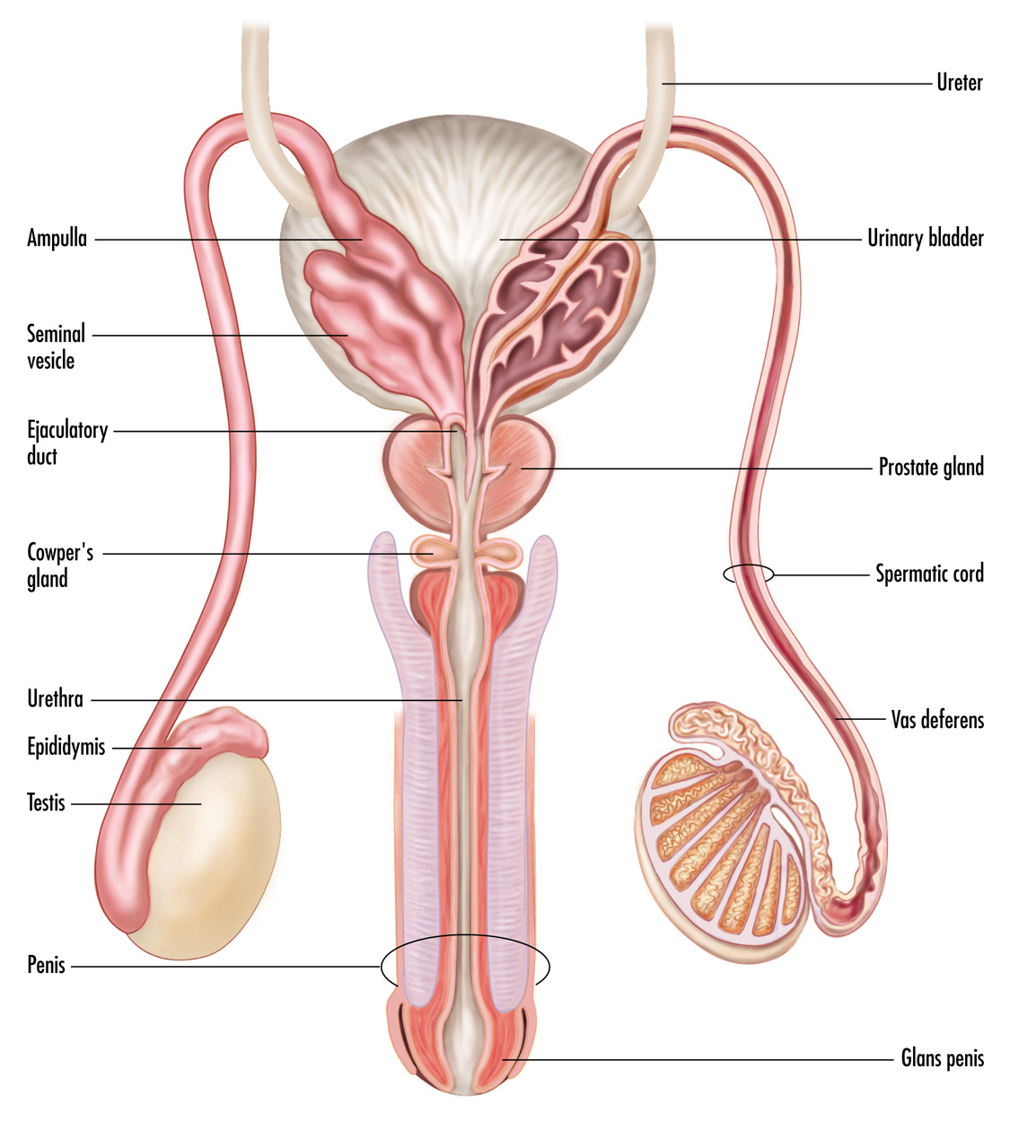
Male reproductive organs
Notes:
Sperm take 72 days to be created.
Internal genitals:
The urethra
The corpora cavernosa and corpus spongiosum
The testis
Vas deferens
Seminiferous tubules – where spermatogenesis takes place, inside testicle
Epididymis – where the sperm mature
Pathway of the sperm:
Ampulla -- widened part of the vas deferens
Seminal vesicles – secret fluid that makes up about 60% of seminal fluid
Prostate gland – secrets about 30-35% of seminal fluid
Cowper’s gland – secret clear mucous prior to ejaculation, its alkaline content may buffer acidity within urethra
Ejaculation and orgasm

Slide 17
Sexual Arousal & Response

Slide 18
Masters & Johnson Sexual Response Cycle
Excitement phase
Plateau phase
Orgasm phase
Resolution phase
  Contains the refractory period for males only

Slide 19
Body’s response to stimulation
Vasocongestion
  body tissues fill up with blood and swell in size
Myotonia - Increased muscle tension
  flexing (voluntary)
  contractions (involuntary)
  Contractions that occur during orgasm
  Also causes facial grimaces, hand and feet twitches
Notes:
Vasocongestion
body tissues fill up with blood and swell in size (e.g., erection, increase in women's breasts, and their vaginas to lubricate when sexually excited. It can affect other parts of the body too, such as the labia, testicles, clitoris, and nipples.
Myotonia
Increased muscle tension that happens during sexual arousal. includes both flexing (which is voluntary) and contractions (which are involuntary).
Most obvious examples are the muscle contractions that occur during both male and female orgasm, but myotonia also causes facial grimaces and twitches in the hands and feet.

Slide 20
Excitement phase
Varies
Includes myotonia, increased heart rate and BP, vasocongestion
Sexual organs often gain a deeper color
Sex flush -- pink or red rash on chest or breasts
  Can occur in men and women, though more common in women.
Notes:
Varies from person to person and situation to situation
Can last anywhere from < minute to over several hours.
Includes myotonia and increased heart rate and Blood pressure. Also, many sexual areas can become engorged with blood, including the clitoris, breast, penis, and testes. The sexual organs often gain a deeper color in this phase as well. A sex flush, which is a pink or red rash on the chest or breasts, can occur in both men and women, though is more common in women. During the excitement phase, a man's penis becomes erect, though the erection is not necessarily completely hard-it can vary between unaroused, partially aroused, and fully aroused states. The testes also elevate and engorge with blood. In women, the clitoral shaft gets bigger, the labia majora separate, and the labia minora enlarge while often becoming darker. Also, some women produce considerable amounts of lubrication at this point, though others only produce a small amount.

Slide 21
Excitement phase cont.
Men:
  penis becomes erect
  testes elevate and engorge with blood
Women:
  clitoral shaft gets bigger
  labia majora separate
  labia minora enlarge and often become darker
  Vaginal lubrication begins, amount varies b/n women
Notes:
Varies from person to person and situation to situation
Can last anywhere from < minute to over several hours.
Includes myotonia and increased heart rate and Blood pressure. Also, many sexual areas can become engorged with blood, including the clitoris, breast, penis, and testes. The sexual organs often gain a deeper color in this phase as well. A sex flush, which is a pink or red rash on the chest or breasts, can occur in both men and women, though is more common in women. During the excitement phase, a man's penis becomes erect, though the erection is not necessarily completely hard-it can vary between unaroused, partially aroused, and fully aroused states. The testes also elevate and engorge with blood. In women, the clitoral shaft gets bigger, the labia majora separate, and the labia minora enlarge while often becoming darker. Also, some women produce considerable amounts of lubrication at this point, though others only produce a small amount.

Slide 22
Plateau phase
Extending plateau may lead to more intense orgasms.
Does not have a clear starting point
Everything in excitement phase continues and becomes more prominent
  Heart and breathing rates keep rising
  Muscle tension increases
  Sex flushes and genital coloration becomes more noticeable.
Outer 1/3 of vagina becomes esp. engorged w/blood, creating a structure called "the orgasmic platform."
Notes:
Note that the word "plateau" is usually used to describe a leveling-off, where there are no real changes. In our stages, however, plateau is not a static, boring place. There are very powerful surges of sexual tension or pleasure that occur in this stage; for example, both men and women often experience faster heart and breathing rates.

Slide 23
Orgasm
Shortest phase of SRC, typically lasting only several seconds.
For Men:
Usually orgasm & ejaculation are experienced together
  But ejaculation does not always occur at the time of orgasm
Seminal fluids gather in ejaculatory ducts & upper urethra producing feeling that orgasm is inevitable.
Notes:
It is interesting to note that orgasms do not seem to differ by gender; that is, men and women feel quite similar things during orgasm. In one study, college students provided descriptions of orgasm. Researchers compared the descriptions using a standard psychological rating scale, and there were no distinguishable differences between men's and women's descriptions. Both males and females tended to describe orgasm with words such as "waves of pleasure in my body," corresponding to the rhythmic muscle contractions that occur during orgasm. In an earlier study, 70 expert judges could not reliably differentiate between the reports of orgasms in men and women.Orgasmic sensation

Slide 24
Orgasm
For Women:
Can have a slightly longer orgasm than men.
Many can experience plateau w/o reaching orgasm
  men almost always orgasm after plateau
Uterus & orgasmic platform contract in rhythmic waves of muscular movement (0.8 sec frequency).

Slide 25
Resolution vs. Refractory
Resolution
  Body returns to its original, nonexcited state.
Refractory Period
  Difference in SRC of males and females.
  Occurs during the resolution phase
  Time when a man cannot reach excitement, plateau, or orgasm through any kind of sexual stimulation.

Slide 26
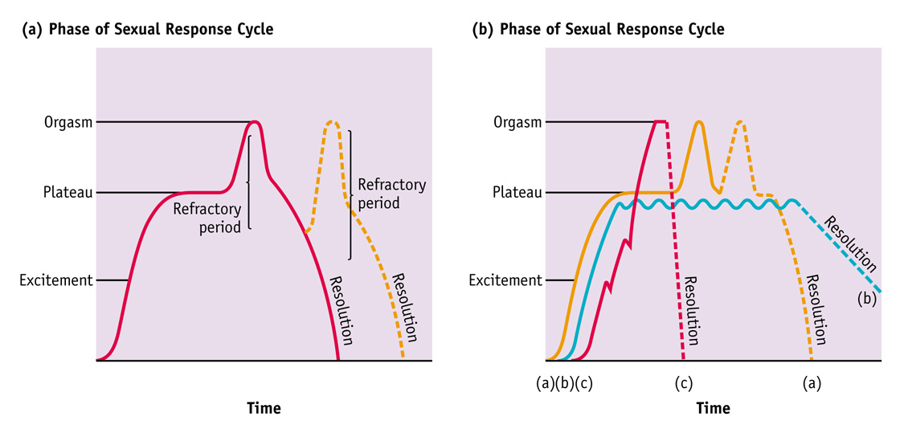
Male Female
Notes:
Orgasm
Orgasm is the shortest phase of the sexual response cycle, typically lasting only several seconds. Women can have a slightly longer orgasm than men. While men almost always experience orgasm after the plateau phase, many women can experience the plateau stage without reaching orgasm. Usually men experience orgasm and ejaculation in conjunction with each other, but ejaculation does not always occur at the time of orgasm. Before ejaculation can occur, the seminal fluids gather in the ejaculatory ducts and upper urethra. This produces a feeling that orgasm is inevitable. Then the semen is expelled out of the penis at the time of orgasm. When a woman orgasms, the uterus and orgasmic platform contract in rhythmic waves of muscular movement.
Resolution
In this phase, the body returns to its original, nonexcited state. Some of the changes occur rapidly, whereas others take more time. The resolution phase begins immediately after orgasm if there is no additional stimulation.
Refractory Period
The refractory period is the one significant difference in the sexual response cycle of males and females. The refractory period occurs during the resolution phase. It is a time when a man cannot reach excitement, plateau, or orgasm through any kind of sexual stimulation. This period can last from a few minutes to days, depending on age and frequency of sexual activity, among other things. Women do not experience a refractory period, and they are capable of reaching orgasm from anywhere during resolution. Women have the potential to have multiple orgasms, but a woman may not want to have a second or third orgasm. In order to determine the woman's feelings on this matter, good communication between partners is extremely important.

Slide 27
Other Models Of Sexual Response
Kaplan’s triphasic model
  Desire, excitement, resolution
Zilbergeld and Ellison’s model
Both of these include desire & account for psychological factors
Masters & Johnson does not address psychological aspects

Slide 28
Goal Driven Model
Kissing
Vaginal Sex
Orgasm
Oral Sex
Fondling

Slide 29
Pleasure Driven Model
Use Sex Toys
Kissing
Oral Sex
Spanking
Showering together
Back massage

Slide 30
Goal vs Pleasure Driven
Kissing
Vaginal Sex
Orgasm
Oral Sex
Fondling
Use Sex Toys
Kissing
Oral Sex
Spanking
Showering together
Back massage

Slide 31
Orgasm
Goal driven experiences vs. pleasure driven experiences
Orgasmic sensation
  similar for males and females
Controversies about orgasm
Notes:
It is interesting to note that orgasms do not seem to differ by gender; that is, men and women feel quite similar things during orgasm. In one study, college students provided descriptions of orgasm. Researchers compared the descriptions using a standard psychological rating scale, and there were no distinguishable differences between men's and women's descriptions. Both males and females tended to describe orgasm with words such as "waves of pleasure in my body," corresponding to the rhythmic muscle contractions that occur during orgasm. In an earlier study, 70 expert judges could not reliably differentiate between the reports of orgasms in men and women.
Types of orgasm: (singer and Singer)
Vulval orgasm (no sexually satiating)
Uterine orgasm (sexually satiating)
Blended orgasm
Freud believed that clitoral orgasm was immature

Slide 32
FAQ and other fun facts
Average penis size?
  5-7 inches when erect
  Smaller penis enlarges more than large flaccid penis
Can I make it bigger?
  Not without risky surgery
  Shaving may make it look bigger
Notes:
Most adult erect ("hard") penises are between five and seven inches long. Also, the size of a guy's penis when it's flaccid ("soft") doesn't really have anything to do with what it will be like when it's erect. Smaller flaccid penises tend to grow more during an erection than penises that are larger when they're soft.
There's no quick way to permanently increase penis size. Most medical authorities agree that vacuum pumps and other gadgets that are advertised to lengthen the penis don't work. The penis may be made thicker by surgically inserting fat from other areas of the body, but most men don't seem to think that the risks of surgery are worth it. And some are plenty grossed out thinking about what happens when the injected fat starts moving around in clumps.

Slide 33
Ejaculate
Speed of ejaculate
  28 miles per hour (www.teenwire.com)
Typical ejaculation ~ 1tsp
5 - 7 calories and some 200 - 500 million sperm (1%).
Other ingredients include:
  Fructose sugar
  Water
  Ascorbic acid (a.k.a., vitamin C)
  Citric acid
  Enzymes
  Protein
  Phosphate and bicarbonate buffers (bases)
  Zinc
Notes:
From go ask alice
the actual amount is determined by a man's age (younger men usually make more semen), when he last ejaculated, and how long he's aroused before ejaculating, among other factors.

Slide 34
Vagina fun facts
Not an open cavity
  Like a balloon that hasn’t been blown up
Length of vagina
  Can range from 3-7 inches, av. ~4 inches
  Can increase with arousal
  Smell
  Just like the penis, has a natural odor
  Do not douche or use “feminine products” with deodorant
Notes:
the upper two-thirds of the vagina to lengthen by forcing the cervix and uterus to ascend.
To change vaginal odor caused by overgrowths of normal skin bacteria, try the following:
Wash your vulva with warm water and unscented, gentle soap with mild antibacterial action (this will help keep the skin intact and make it less likely for microscopic cracks to develop, where bacteria like to grow).
- Wear underwear and exercise clothes made from materials that "breathe," such as cotton.
- Wear loose pajama bottoms or a night gown -- or nothing at all -- to let your vulva "breathe."
- Keep your vulva as dry and aired as possible because bacteria love moist, dark, and trapped environments.
- Don't use antiperspirants, deodorant tampons, and powders with talc or perfumes or other feminine hygiene ingredients, because they can be irritating.
- Douche no more, since it has been linked to Pelvic Inflammatory Disease (PID). If deemed necessary, douching should be done only under the direction of a health care provider. Otherwise, douching is not recommended.

